Slide 1
Anaplan
Go-to-market Planning Applications
Sales Forecast
Technical Overview
Application Version 1.1.0
Last updated February 5, 2026

Slide 2
Confidentiality notice
This documentation and any related materials are provided solely for the use of authorized Anaplan customers who have purchased the Sales Forecast and are considered Anaplan proprietary information. The information contained herein is intended exclusively for the purpose of implementing the application by authorized customers. Any use outside of this intended purpose is strictly prohibited, including but not limited to:
  Sharing, distributing, or disclosing this content with or to individuals or entities not directly involved in the customer’s authorized implementation.
  Using the documentation, in whole or in part, to replicate, retrofit, or reverse-engineer the functionality in other models, environments, or platforms.
This documentation contains proprietary information of Anaplan and is protected by applicable intellectual property laws. Any unauthorized use, reproduction, or dissemination is a violation of these terms and may result in legal action.

Slide 3

Table of Contents
1
Application overview
2
Process & configurable elements
3
Prework & assumptions
4
Implementation model design

Slide 4
Application overview
Section 1

Slide 5
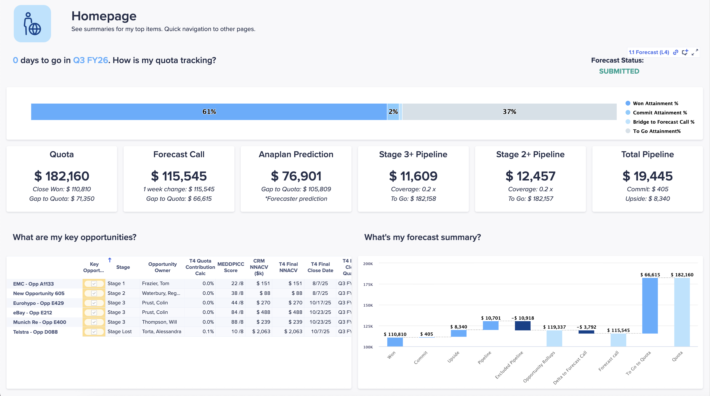
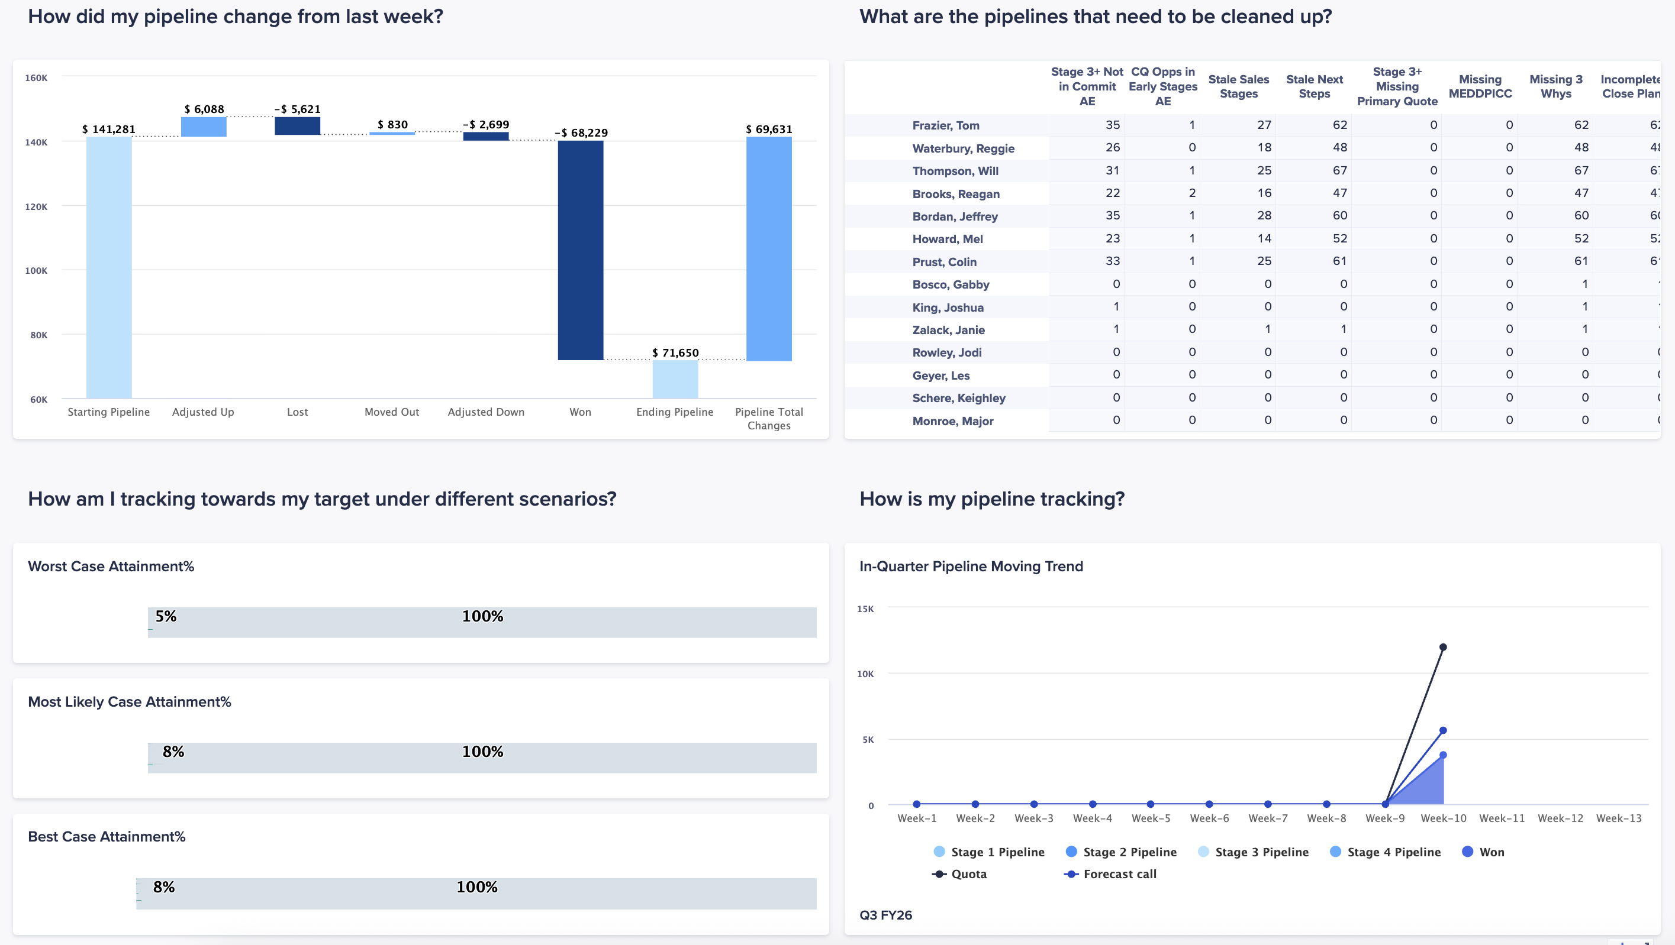
Sales Forecasting
Out-of-the-box functionalities to support forecasting, pipeline, accounts, and insights
Forecast:
Forecasting and Performance: Submit and analyze individual and team-level forecasts, tracking performance against quotas and historicals
Opportunity Management: providing a high-level summary of the sales pipeline and allows users to drill down into the details of individual deals, such as product information, qualification status, and closing plans.
Scenario Planning: Utilize interactive dashboards to build and compare different forecast scenarios (e.g., "Worst," "Most Likely," and "Best Case") to understand potential outcomes and inform strategic planning.
Pipeline:
Pipeline Analysis designed to track the health and progress of the sales pipeline against set targets. Provides multi-quarter view of the pipeline and key metrics for various sales stages.
Pipeline Generation tracks the creation of new sales opportunities against targets. Providing a detailed breakdown of generation momentum allowing users to monitor their performance.
Pipeline Hygiene: identifies sales opportunities that have data quality issues or require immediate action. Allowing sales teams to quickly clean up their pipeline data for more accurate forecasting.
Analytics showing the sales pipeline has changing over a specific, user-defined period. Allowing for a deep analysis of pipeline dynamics.
Account:
Growth Opportunity: Identify upsell and cross-sell opportunities by analyzing "white space" (unsold products) and tracking the complete history of all sales and marketing engagement with a customer making it easy to spot and prioritize growth areas within an account.
Insights:
Historical Performance: Review historical business performance with dashboards that visualize key trends, win/loss reasons, and pipeline conversion rates, enabling leaders to understand and improve sales outcomes.
Channels:
Channel Performance: Monitor and analyze the business performance of sales partners with both high-level overviews and detailed drill-downs into key metrics.
Product Performance: Analyze sales from a product-centric perspective, providing overviews across all product families and enabling deep-dives.

Slide 6
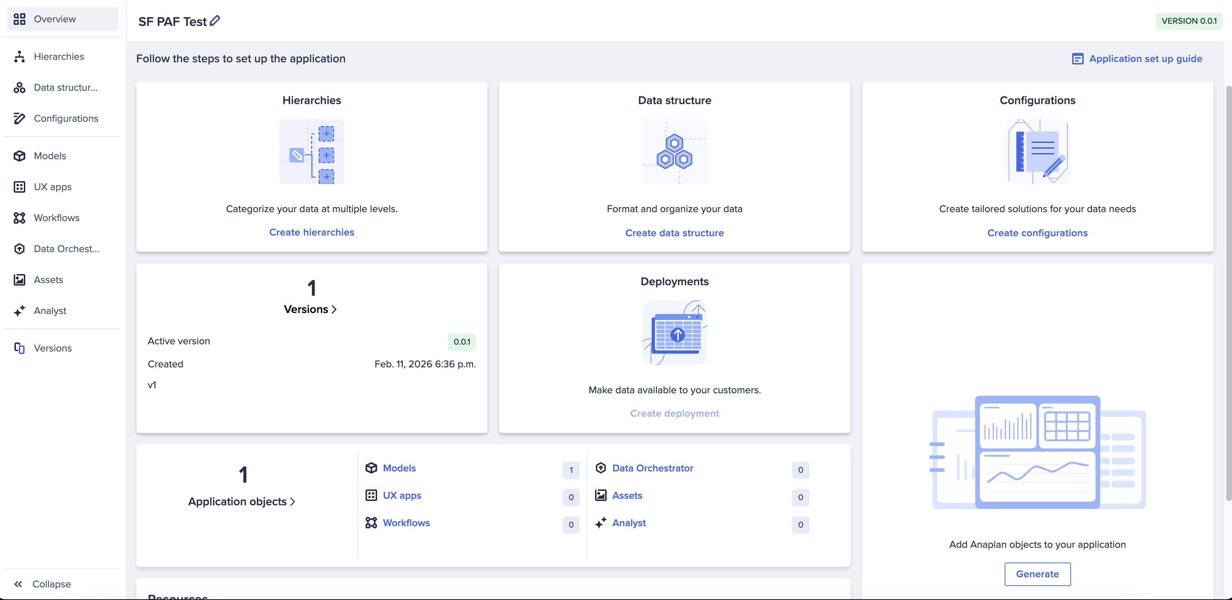
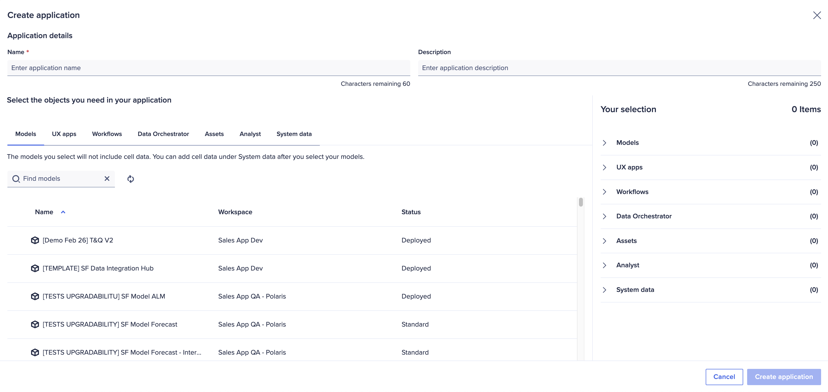
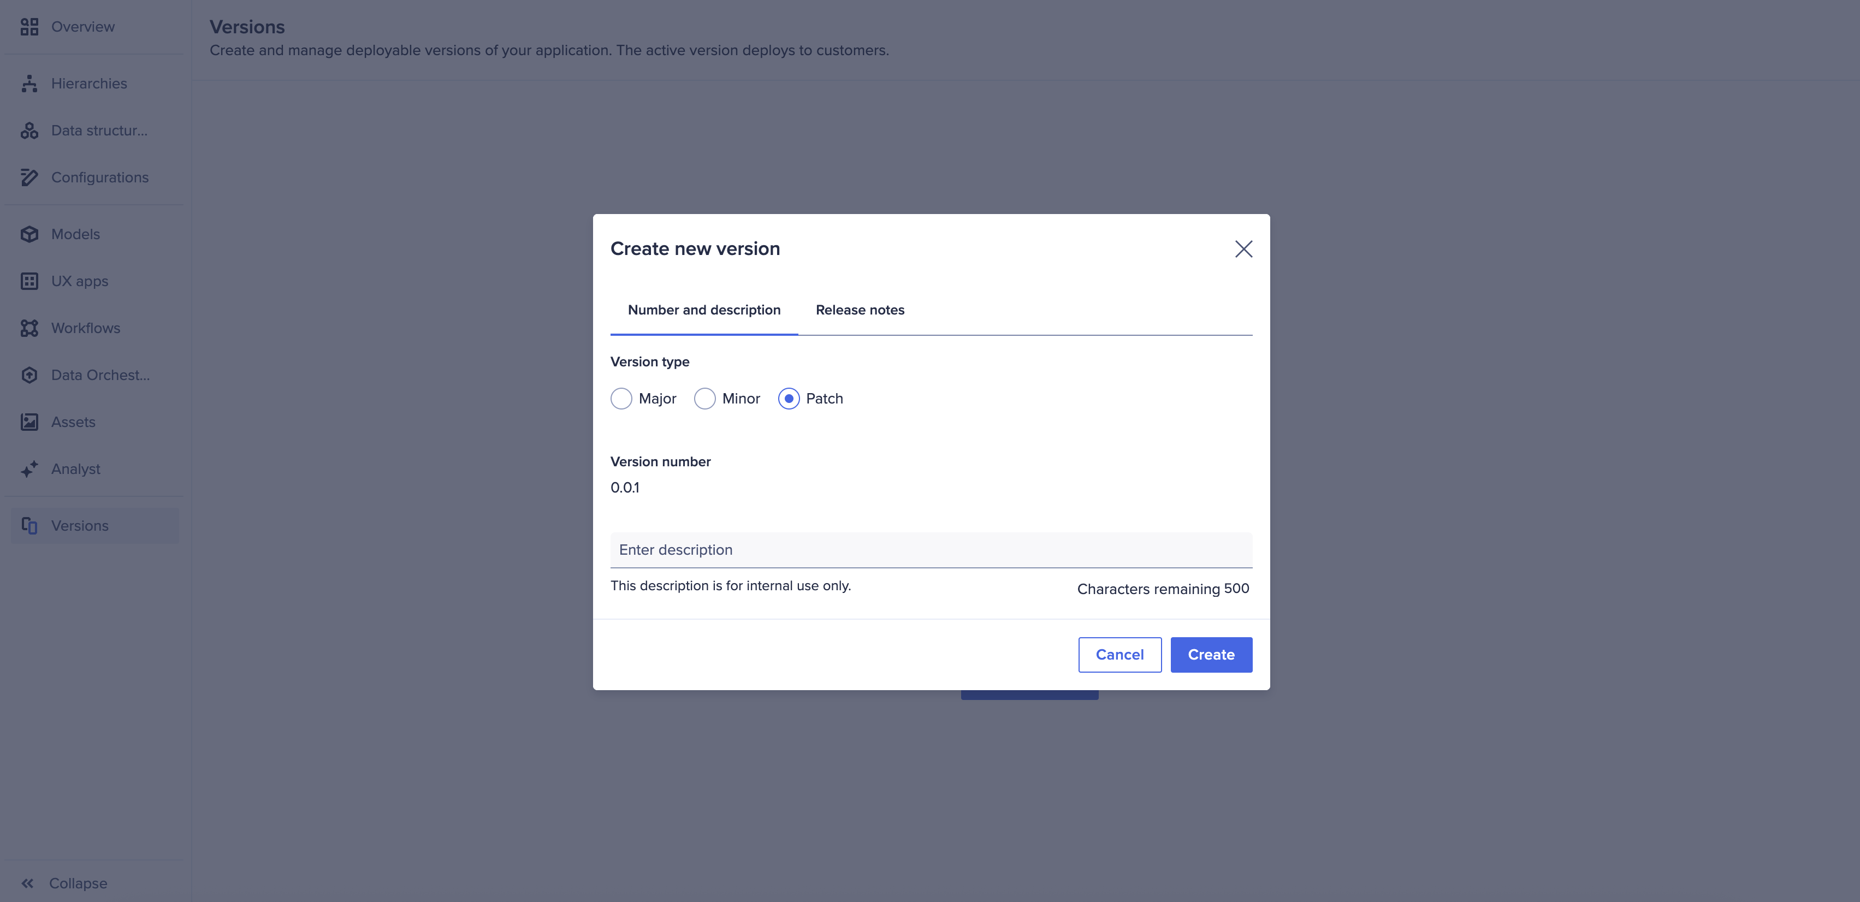
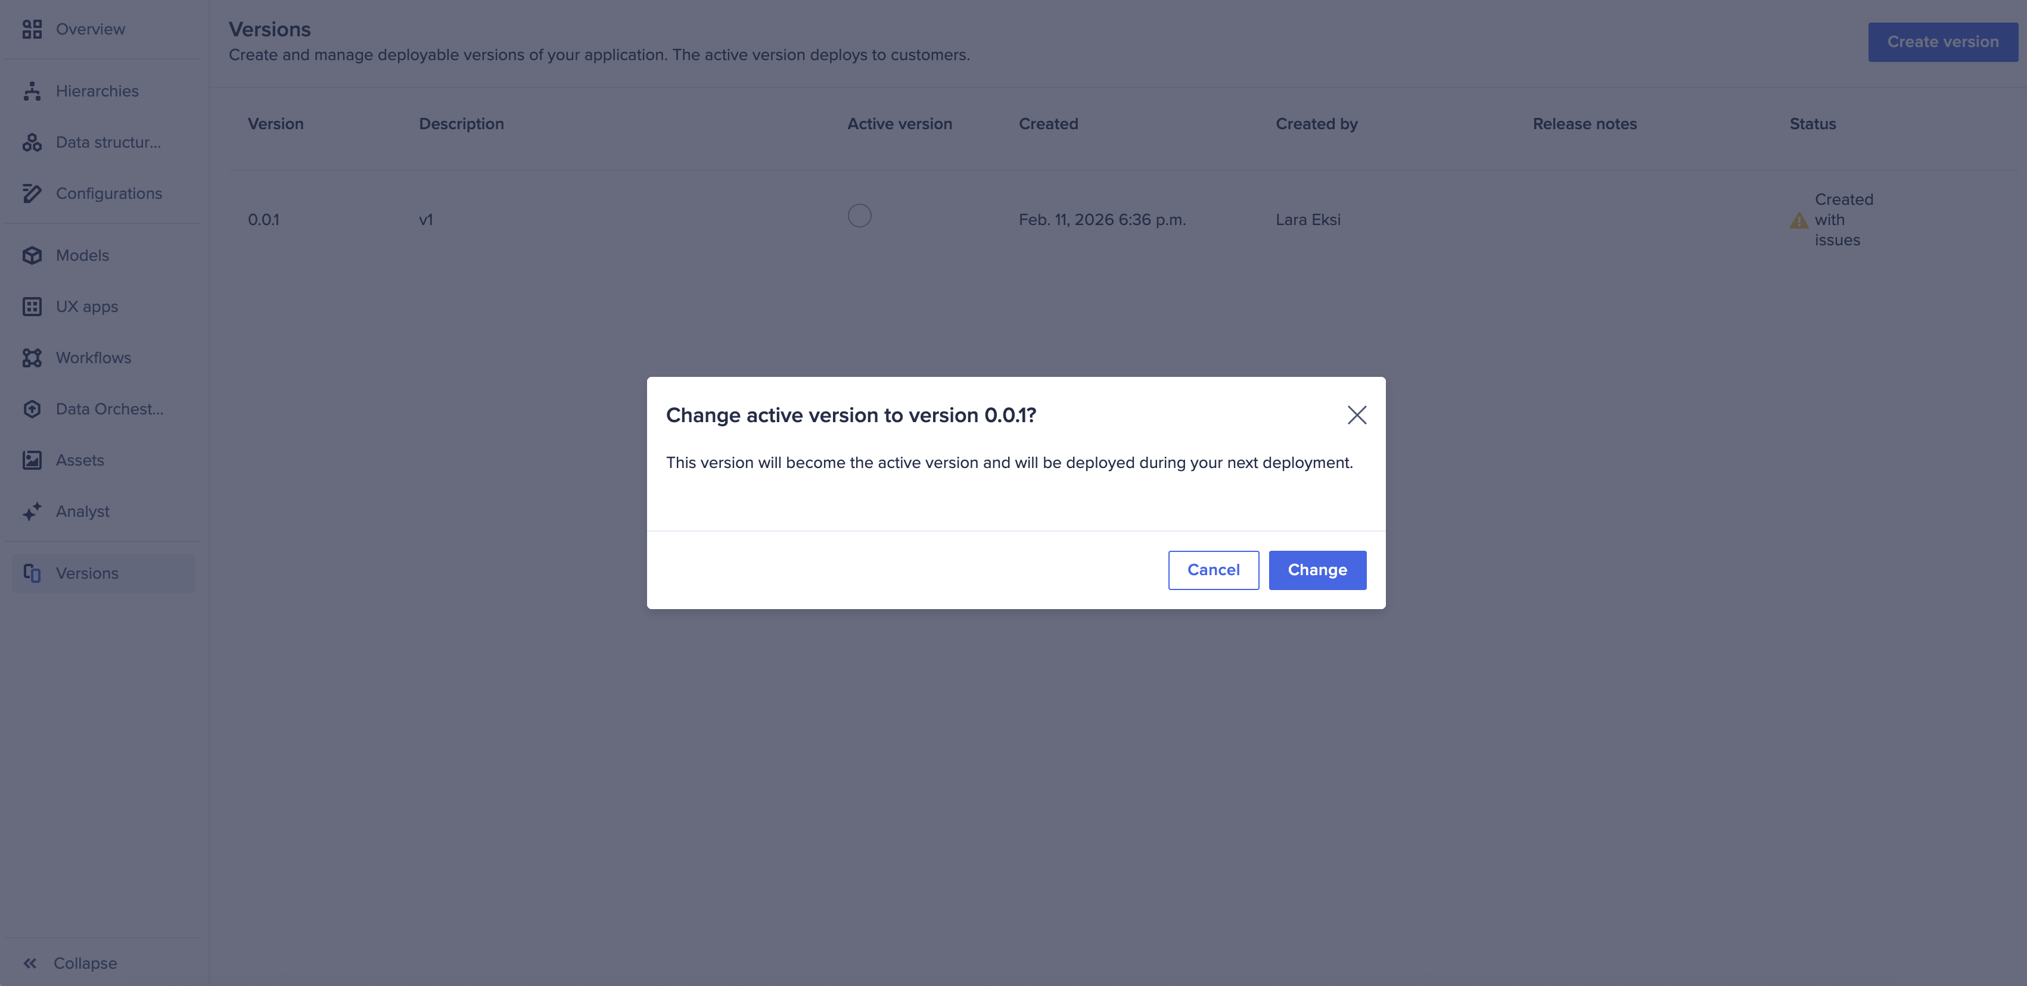
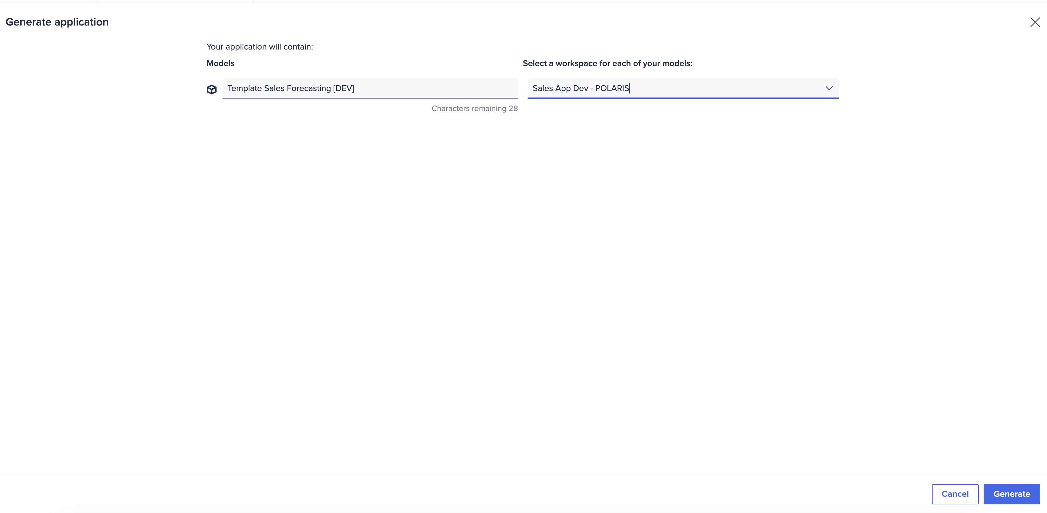
Guided setup powered by the Anaplan Application Framework
Designed to get you to value faster with a proven, repeatable configuration flow
Guided Setup
Quickly configure your application by answering structured questions about your business model, GTM structure, and planning needs. No blank canvas required.
1
2
3
4
Step-by-step
configuration
Deploy…
Source
Version
Activate Version
Generate

Slide 7
Anaplan Go-to-Market Planning
Application Implementations
3-step implementation: Configure. Extend. Deploy.
Start with a guided setup that builds your model and UX automatically, based on structured inputs about your hierarchies, data, naming conventions, and GTM logic. Your planning foundation is purpose-built from day one.
Configure
Extend
Adapt and expand the application to reflect your business’s unique needs. Leverage the power of Anaplan’s flexible modeling platform to make the
app your own, without starting from scratch.
Deploy
Move quickly into testing and rollout. This accelerated path to deployment helps you capture value sooner, with built-in best practices and a launchpad for future expansion across your business, ready to evolve alongside your business with additional Anaplan applications or purpose-built extensions.

Slide 8
Process and configurable elements
Section 2

Slide 9
Sales Forecast Planning framework
1. Forecast
2. Pipeline
3. Account + Insights
CRM System
1.1 Review & adjust individual forecast and team forecasts
2.1, 2.2 Track current pipeline status and gap to target
3.1 Identify account upsell and cross-sell opportunities
ADO
1.2 Review and enter Opportunity details
2.3, 2.4 Monitor pipelines hygiene and changes over-time
3.2 Review historical business trends and leading performers
Booking System
1.3 Opportunity level scenario planning
1.4, 1.5 Anaplan vs Manual Forecast comparison
T&Q Model
Segmentation Model
Subscription Revenue Planning
Notes:
Bottom-up scenario planning

Slide 10
Prework and assumptions
Section 3

Slide 11
Assumptions
To successfully implement this application as designed, the planning process must meet the following assumptions.
Assumptions:
Your planning process includes a sales hierarchy.
You must have employees as the lowest level of your sales hierarchy.
If these are not true today, there are two options:
Modify or extend the application to accommodate the existing planning model.
Adjust the planning process to align with supported methodologies and industry best practices.

Slide 12
Sales Forecasting Data Requirements and Description
Data | Description | Mandatory Attributes​
Actuals (ie. Orders) | This should contain two data files where the second is a more detailed line-item level (i.e., Orders and order details where the order details contain details by products). | ID, name, account, product, date, amount, opportunity, employee If using the detailed data file, have an ID to link to the initial file The mandatory attributes must be present between the two data files
Forecast (ie. Opportunities) | This can be either one data file or can be loaded with two data files where the second is a more detailed line-item level (i.e., Opportunities and opportunity details where the lines contain details by products). | ID, name, account, planning measure, product, date, amount, attribute to filter likely deals (such as forecast category or deal stage) If using the detailed data file, have an ID to link to the initial file The mandatory attributes must be present between the two data files
Targets (ie. NNACV, Source & Opportunity Type, Meetings) | This can be either one data file or can be loaded with three data files. Where the 1st data file is all NNACV targets, the second is the targets by Source and Opportunity Type, and the third is Meeting targets. | All data fields within the DAT: NNACV Target and Pipeline Target module are required.
Note: CSV files must be a flat view with the attribute fields in columns and items in rows. The files can include additional attribute fields. Additional data files are also prohibited.

Slide 13
Metadata requirements and description
Dimensions | Description | Mandatory attributes
Accounts (could also be clients, customers, etc.) | Account data provides a complete, real-time view of each customer, enabling sales teams to prioritize opportunities effectively through data-driven scoring and predictive analytics. | Account Owner Territory Account Segment NAICS Industry ARR $k Account Wallet Size Intent Score | Engagement Score Note Partner No. Employees Annual Revenue Website URL
Product (could also be offerings, services, etc.) | Product data provides the granular detail needed to predict sales for individual products. By analyzing product attributes and historical performance, businesses can identify specific trends | Name ID Parent
Employee (could also be sales reps, sellers, etc.) | Employee data links the sales plan to the people executing it ensuring that forecasts are grounded in the actual capabilities of the sales force. Allowing for a more realistic and reliable forecast by aligning its sales resources with market opportunities. | Name ID Parent Photo URL | Hire Date User Name Email Territory
Territory | Territory data provides the geographic structure needed to organize sales efforts and analyze performance. By establishing a clear hierarchy, we can roll up forecasts from the individual rep to a regional or national level, providing a clear, data-driven view of performance. | Name ID Parent Territory manager
CSV files should be a flat view with the attribute fields in columns and dimension items in rows.
Files can include additional attribute fields and can bring additional dimensions and hierarchies in as needed.
Where numbered lists are referenced the value loaded to that field should be the code, not the name
For files that contain hierarchies, these must be in parent child format. There is no need to include a parent for the first level of the hierarchy.

Slide 14
Metadata requirements and description
Dimensions | Description | Mandatory attributes
Sales Hierarchy | Sales hierarchy data provides the essential structure for the forecasting process, allowing individual forecasts to be aggregated or "rolled up" from sales reps to managers and executive leaders. This framework creates clear lines of accountability, as each level of the hierarchy is responsible for the forecast of the teams below it. | Name ID Parent
Sales Role (Seller type) | Sales role data defines the different personas within the sales organization, such as Sales Representative, Manager, and Sales Ops, each with specific responsibilities and views of the forecast. It ensures that the forecast aligns with the real-world structure and responsibilities of the sales team. | Name ID
CSV files should be a flat view with the attribute fields in columns and dimension items in rows.
Files can include additional attribute fields and can bring additional dimensions and hierarchies in as needed.
Where numbered lists are referenced the value loaded to that field should be the code, not the name
For files that contain hierarchies, these must be in parent child format. There is no need to include a parent for the first level of the hierarchy.

Slide 15
Model design
Section 4

Slide 16
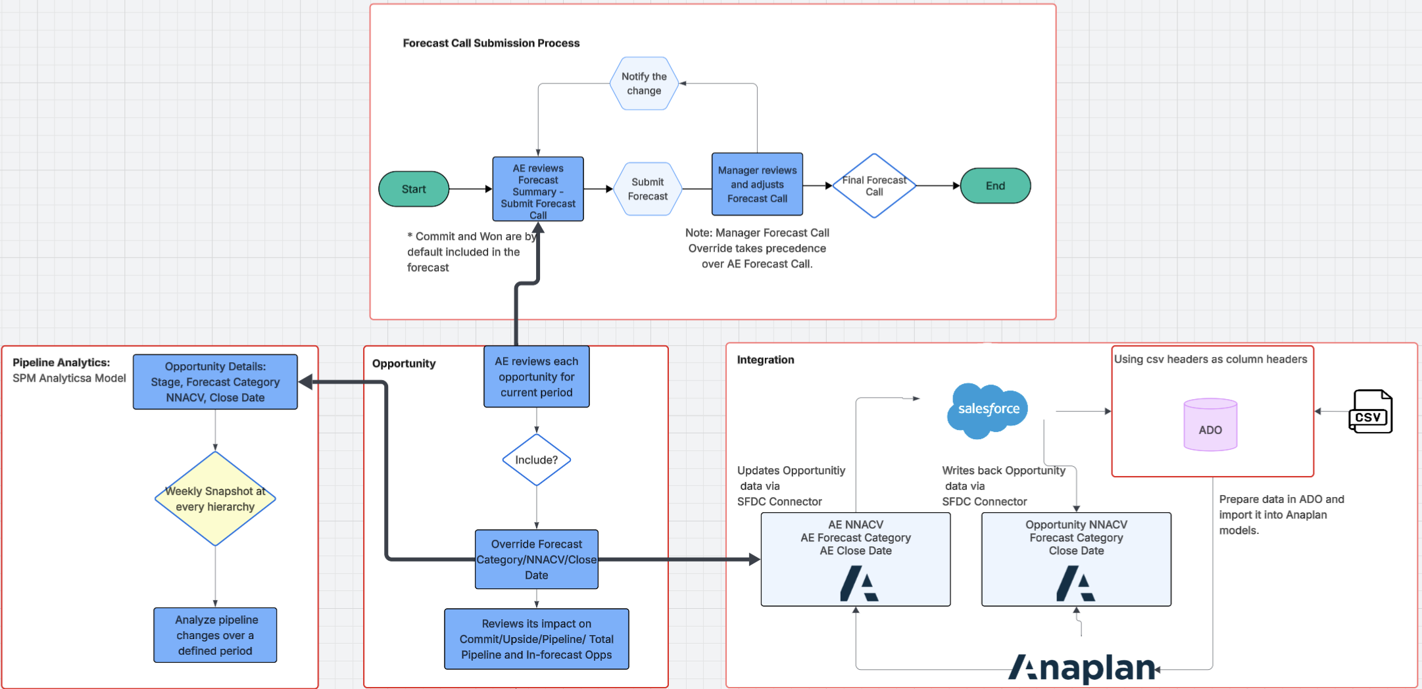
Model diagram overview​

Slide 17
Forecast
Objective: To serves as a central hub for sales forecasting and pipeline management.
Its primary functions allow users to:
  Analyze Pipeline Summaries: Access a consolidated, high-level overview of the sales pipeline to assess its health and trajectory.
  Evaluate Forecast Methodologies: Review and compare personal forecast projections derived from multiple analytical models and data sources.
  Submit Forecast Calls: Formally enter and commit to a forecast for a specific period.
  Manage Team Forecasts: Enable managers to review their team’s submitted forecasts, make necessary adjustments, and apply overrides to finalize commitments.
  The process for forecast submission is a structured, hierarchical workflow designed to ensure accuracy and accountability.
Steps | Action | Key details
Review | The Account Executive (AE) reviews their forecast summary. | Opportunities marked as "Commit" and "Won" are automatically included in this initial forecast view.
2. Submit | The AE submits their official forecast through the dashboard. | This represents the AE's formal commitment for the period.
3. Adjust | The Manager reviews the AE’s submitted forecast. | The Manager has the authority to make adjustments or overrides based on their assessment.
4. Finalize | The Manager’s forecast call overrides the AE’s submission. | This rule is critical: the manager's final number takes precedence, creating a single, authoritative forecast.
5. Notify | A notification is triggered by Manager if a change is made. | This ensures the AE is aware of any modifications to their original forecast.

Slide 18
Opportunity
Objective: To provide a detailed, interactive workspace for building an accurate, bottom-up forecast by enabling granular review, adjustment, and planning for individual sales opportunities.
Key Capabilities | User Workflow for Forecast Construction
Detailed Opportunity Management Review opportunities in comprehensive detail.• Adjust key opportunity values (e.g., NNACV, Close Date) as needed. | 1. Review & Plan Select an individual opportunity to drill down into its details.• Formulate and create the Close Plan for the deal directly within the dashboard.
Bottom-Up Forecasting Use include/exclude checks at the opportunity level to build a forecast from the ground up. | 2. Include or Exclude For each opportunity, make a simple "Yes/No" decision to include it in the forecast calculation.
Managerial Oversight Drill down into a specific representative's deals to evaluate their entered forecast call and underlying opportunities. | 3. Adjust & Analyze If included, override key fields like Forecast Category, NNACV, or Close Date. Immediately see the impact of any changes on the overall forecast summary.

Slide 19
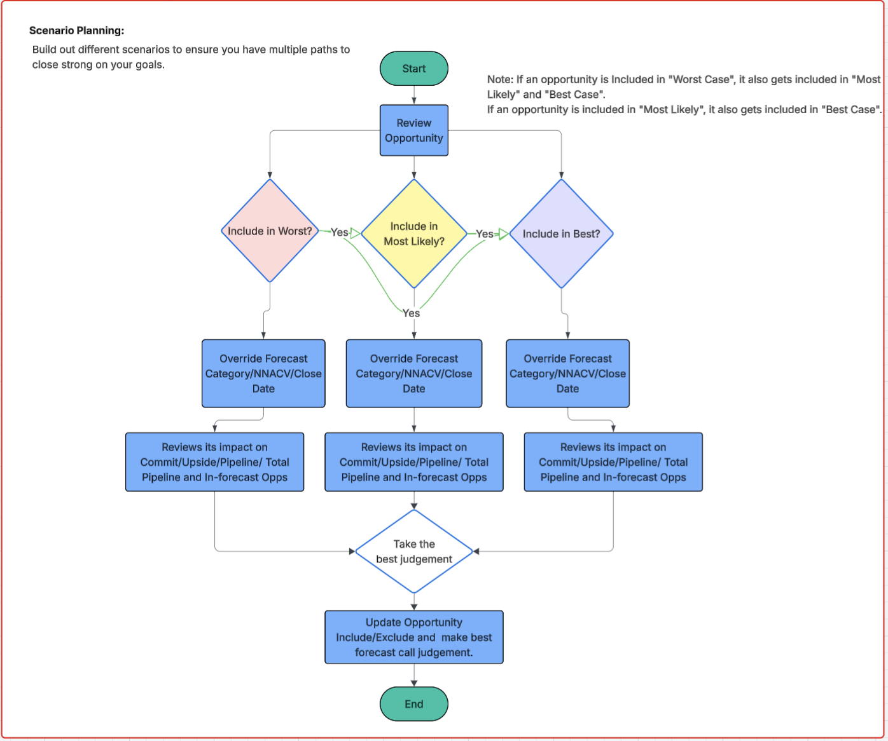
Scenario Planning Schema

Slide 20
Scenario Planning
Objective: To provide a dedicated workspace for sales leaders to run what-if analyses, model different outcomes, and build multiple paths to ensure they can close strong on their goals.
Key Capabilities | User Workflow for Scenario Modeling
"What-If" Analysis Engine Answer questions like: "What if this deal's value changes?" or "What if this deal closes next month instead of this month?" | 1. Review Opportunity The process begins by selecting an individual opportunity to analyze.
Multi-Scenario Comparison Build out three distinct, hierarchical forecast scenarios: Worst Case, Most Likely, and Best Case. Rule: "Worst Case" deals are automatically included in "Most Likely," which are in turn included in "Best Case" and "Most Likely" deals are automatically included in "Best Case". | 2. Build Scenarios For each scenario (Worst, Most Likely, Best), decide if the opportunity should be included. Override key fields (NNACV, Close Date, Forecast Category) to reflect that specific scenario. Instantly review the impact of each adjustment on the totals for that scenario.
Track Attainment Paths Visualize the potential attainment outcomes under each different scenario. Empowers managers to proactively plan and de-risk their forecasts. | 3. Make a Final Judgement After comparing the outcomes of all three scenarios, make the best-informed forecast call. Update the official opportunity record based on this comprehensive analysis.

Slide 21
Pipeline and Pipeline Generation
Objective: To provide a comprehensive view of current pipeline health against targets and future pipeline generation momentum, enabling proactive management from leadership down to the individual representative.
Current Pipeline Health & Coverage | Pipeline Generation & Momentum
Track Coverage vs. Target Monitor the current pipeline and its coverage ratios across various stages against established targets. | Track Generation vs. Target Monitor pipeline generation momentum and track progress towards quarterly or annual targets.
Inspect & Identify Gaps Drill down by stage, region, and other dimensions to identify opportunities for pipeline progression and to bridge any gaps. | Monitor Generation Activities Track the specific sales activities (e.g., calls, meetings) that are contributing to pipeline generation.
Rep-Level Action Planning Inspect pipeline health by individual representative to create targeted, actionable plans to improve their pipeline. | Review Rep Momentum & Activity Analyze pipeline generation momentum by rep and review their specific activities to provide coaching and drive performance.
Key Benefits:
Granular Inspection: Easily drill down to inspect the current pipeline and challenge the values of individual opportunities.
Data-Driven Planning: Instantly identify historical win rates, sales velocity, and average days-in-stage to calculate the precise pipeline needed to hit future targets.
Momentum Analysis: Quickly inspect and understand the momentum behind all pipeline generation efforts, from high-level trends down to individual rep activities.

Slide 22
Pipeline Analytics
Objective: To provide deep insights into pipeline dynamics by capturing weekly snapshots of opportunity data, enabling users to analyze how the pipeline has changed between any two points in time and instantly answer the question: "What happened?"
Key Capabilities | Data & Analytical Workflow
Point-in-Time Comparison Analyze pipeline changes between any two defined periods (e.g., this week vs. last week). | 1. Data Source: The Opportunity Workflow The process begins with the live opportunity data that Account Executives manage daily. All overrides to an opportunity's Forecast Category, NNACV, or Close Date serve as the source data.
Automated Weekly Snapshots The system automatically captures a comprehensive snapshot of all opportunity details at every level of the sales hierarchy on a weekly basis. | 2. Capture Weekly Snapshot Every week, the system records the key details (Stage, Forecast Category, NNACV, Close Date) for all opportunities. This creates a historical record of the pipeline's state.
Change Driver Analysis Instantly diagnose pipeline swings by identifying the specific deals that have been added, removed, pulled-in, pushed-out, or have changed in value. | 3. Analyze Period-over-Period Change The user selects two snapshots to compare. The dashboard then analyzes the differences between these two data sets to provide a clear, actionable summary of all pipeline changes.

Slide 23
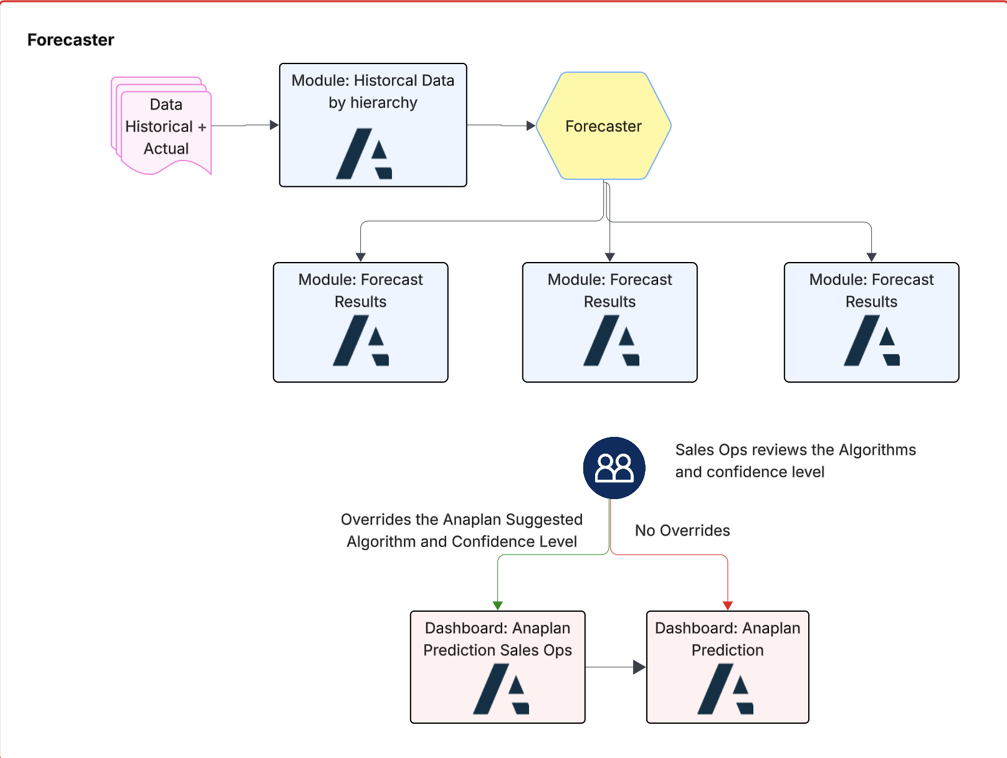
Forecaster Schema

Slide 24
Forecaster
Objective: To leverage historical data and predictive algorithms to generate a statistical forecast baseline, which is then refined and validated by Sales Operations to create a final, trusted prediction.
Why Anaplan Forecaster?
Anaplan Forecaster is essential for moving beyond manual, often biased forecasting methods.
It introduces a layer of data science into the planning process without requiring users to be data scientists, leading to higher accuracy by using advanced
algorithms to identify complex patterns and seasonality that humans might miss.
Its key advantages are generating more reliable forecasts through automation and providing full transparency into the forecast drivers, which builds trust and empowers business users to make more confident, data-driven decisions.
Key Components | Automated Forecasting & Review Workflow
Data Foundation Ingests Historical and Actual performance data. | 1. Data Ingestion & Structuring Data is loaded into an Anaplan module and organized by business hierarchy (e.g., by region, team).
Predictive Engine A central "Forecaster" uses this data to generate multiple forecast results using different algorithms. | 2. Automated Forecast Generation The Forecaster runs its analysis and outputs several potential Forecast Results.
Human-in-the-Loop Validation Sales Ops applies expert judgment to the machine-generated outputs. | 3. Sales Ops Review & Validation The Sales Ops team reviews the suggested algorithms and their associated confidence levels.
Final Prediction Dashboards Produces the final, authoritative forecast in an Anaplan Prediction Dashboard. | 4. Override or Approve If needed, Sales Ops can override the system's choice and publish an adjusted forecast. The final, validated prediction is then published for use in downstream planning.

Slide 25
Integration
The Connector:
The Anaplan for Salesforce Connector is an application installed directly into Salesforce. It provides a user interface for administrators to precisely control the integration.
It allows for the mapping of Salesforce Objects (Opportunity) and their fields to the corresponding Anaplan model, lists, and line items.
NNACV, Forecast Category and Close Date gets updates from Anaplan to Salesforce directly via the SFDC Connector. Likewise, the change flows back into Anaplan Data Module via Salesforce.
Anaplan Data Orchestrator (ADO)
Data Orchestrator is a data integration feature on Anaplan. It enables integration administrators to import, transform, and load data into Anaplan models.
ADO is compatible with external source systems with following connectors.
Load the data into Anaplan via ADO by connecting it to external source systems or by local csv files.

Slide 26
Pipeline Hygiene
Objective: To highlight the opportunities that do not comply with company sales process rules and require immediate attention to ensure a clean, accurate, and reliable sales pipeline.
Key Data Quality Issues Highlighted | User Workflow & Actions
Stalled & Aging Deals Flags opportunities that have remained in the same stage for too long without meaningful activity. | 1. Review Non-Compliant Deals The dashboard surfaces a clear, actionable list of all opportunities that violate established data quality or sales process rules.
Missing Next Steps Identifies deals that do not have a clear, scheduled next action (e.g., a follow-up call or meeting). | 2. Drill Down to Rep & Deal Level Managers and reps can drill down to investigate specific deals, identify the root cause of the hygiene issue, and determine the best course of action.
Incomplete or Inaccurate Data Pinpoints opportunities with missing critical information, such as close dates, deal values, or key contacts. | 3. Take Corrective Action Reps can directly take action to clean up the data, schedule the required next steps, or advance/disqualify the opportunity to resolve the issue.

Slide 27
Accounts
Objective: To provide a holistic, 360-degree view of each account, transforming the focus from individual deals to strategic, long-term relationships and identifying all potential revenue opportunities.
Key Capabilities & Insights | User Workflow for Strategic Planning
Whitespace Analysis Provides a clear matrix of accounts versus products, instantly revealing gaps where key products have not yet been sold (i.e., the "white space"). | 1. Identify Growth Accounts Users can filter and sort accounts by size, industry, or current product penetration to identify the highest-potential targets for growth.
Upsell & Cross-sell Identification Automatically flags accounts with a high potential for upsell (selling more of the same) or cross-sell (selling new products). | 2. Analyze Whitespace & Engagement For a target account, review the whitespace analysis to see what they don't own. Cross-reference this with engagement data (e.g., recent marketing clicks, support tickets) to gauge interest.
360° Engagement View Consolidates account-level engagement and outreach data from various sources to provide a complete picture of all recent interactions. | 3. Formulate Account Plan Based on the data, build a targeted outreach plan for prospecting, focusing on the most relevant upsell or cross-sell opportunity.

Slide 28
Overlay: Channels and Product
Objective: To provide specialized overlay teams with a tailored view of the pipeline, enabling them to track performance against their unique targets and collaborate effectively with the core sales organization.
Channel Overlay View | Product Overlay View
Track Channel Targets Monitor performance and target attainment for deals sourced or influenced by partners. | Track Product Targets Monitor performance against quotas for specific products or product families.
Partner-Centric Pipeline View a filtered pipeline that shows only deals associated with a specific channel or partner. | Product-Centric Pipeline View a filtered pipeline that shows only deals containing a specific product, regardless of the sales region.
Drill Down to Details Analyze the details of channel-related opportunities to provide support and ensure deal progression. | Drill Down to Details Analyze the specifics of product-related opportunities to offer expert guidance and help the core AE close the deal.

Slide 29
For more information, refer to applications.anaplan.com

